Slide 1
History of Disability and Aging Advocacy in Iowa
“Where the Rubber Hits the Cornfield!”
Heartland Self Advocacy Resource Network – May 6, 2016

Slide 2
Webinar brought to you by:

Slide 3
Where the Rubber Hits the Cornfield
Presenters
Dawn Francis – Iowa Statewide Independent Living Council
Mia Peterson – National Self Advocate
Mike Hoenig– Peer Action Disability Support (PADS)
Jeremy Beavers – People First of North Iowa
Gary McDermott – Disability and Veterans Advocate
Don Dew- Disabilities Resource Center of Siouxland
Jim Cushing - Iowa Aging Network
Special thanks to Greg Fier & Doug Cunningham for putting the presentation together.

Slide 4
What You Will Learn
Lessons from Self Advocates on what works and what does not to get what you want
How to make a difference
How to bring people together around a cause
Struggle
Partner
Listen
Believe
Participate
Advocate

Slide 5
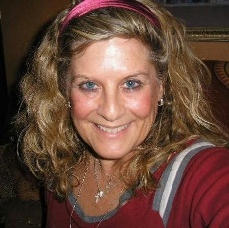
History of Disability and Aging Advocacy in Iowa
“Where the Rubber Hits the Cornfield!”
The History of the National Disability Rights Movement – Dawn Francis

Slide 6
Dawn Francis
Executive Director
Iowa Statewide Independent Living Council (SILC)

Slide 7
The Rise of the National Independent Living Movement
Dawn Francis
Ed Roberts was a young man in the early 1960’s, who was a quadriplegic and needed to sleep in an iron lung for 10 hours a day
Ed fought the California Department of Vocational Rehabilitation, and the University of California at Berkeley, for the right to go to college and get a degree.
The Rise of the National Independent Living Movement – Dawn Francis

Slide 8
The Rise of the National Independent Living Movement
Dawn Francis
Ed won, and began recruiting others with disabilities to the Berkeley campus. They began making the campus more accessible, and finding apartments off campus that were either accessible or could be made accessible.
Ed and his colleagues received $1 million dollars in the early 1970’s to start the first Center for Independent Living in Berkeley
The Rise of the National Independent Living Movement – Dawn Francis

Slide 9
The Rise of the National Independent Living Movement
Dawn Francis
He later went on to become the Director of the California Department of Vocational Rehabilitation, the same organization that he had to fight for the right to attend college.
From these early beginnings, Ed and others mobilized individuals with disabilities all across the country to advocate for their Civil Rights in all areas of living.
The Rise of the National Independent Living Movement – Dawn Francis

Slide 10
The Rise of the Independent Living Movement
The federal Vocational Rehabilitation Act of 1973 established Vocational Rehabilitative Services as well as Centers for Independent Living, although we had to fight for 3-4 years to get funding for Centers.
The Americans with Disabilities Act (ADA) was passed in 1990.
The 1999 Olmstead Supreme Court Decision was another important event that enforced the idea that people have the right to live in the community and not be forced to live in institutions.
The Rise of the Independent Living Movement – Dawn Francis

Slide 11
The Capital Crawl
PLAY VIDEO – CAPITAL CRAWL
Reported by PBS, Independent Lens and introduced by Iowa Senator, Tom Harkin
To give you just a sample of the disability rights advocacy that has happened at the national level to bring us our freedoms in the disability world, here is a short clip that talks about the “Capital Crawl”. This was an event conducted to bring attention to the lack of accessibility for people with disabilities, and to promote the need for the passage of the Americans with Disabilities Act (ADA).
The Rise of the Independent Living Movement – Dawn Francis

Slide 12
Iowa and Nebraska Advocates at the National Council on Independent Living (NCIL). Annual Conference March and Rally, Washington, DC.
During the 25th Anniversary of the Americans with Disabilities (ADA) Act
And of course, we must honor the Iowan who took the lead in helping to develop and pass the Americans with Disabilities Act, our own Senator Tom Harkin!
At the NCIL Rally in Washington, DC

Slide 13
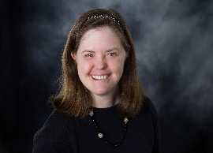
History of Disability and Aging Advocacy in Iowa
“Where the Rubber Hits the Cornfield!”
National Advocacy From Iowa – Mia Peterson

Slide 14
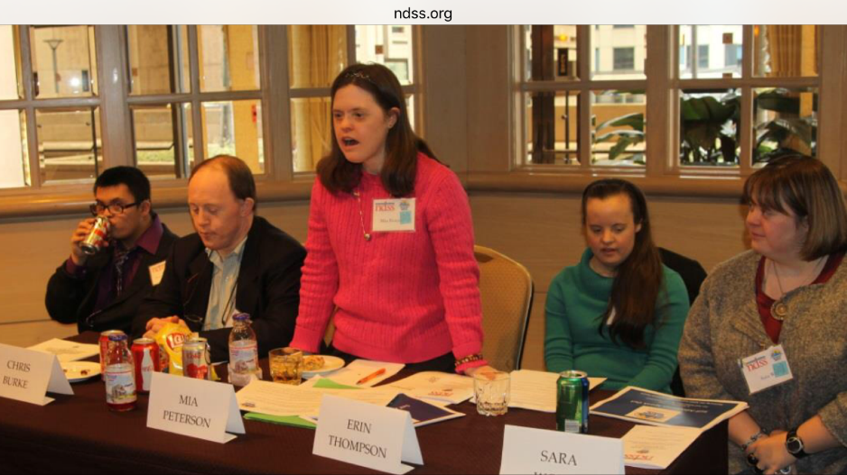
Mia Peterson
Nationally Acclaimed Self Advocate from Iowa
I’m Mia Peterson and I am a self-advocate!
I live in Des Moines and work at the YMCA and a local grocery store.
I have my own personal business giving speeches on self-advocacy, self-determination and living independently.

Slide 15
Mia Peterson
National Self Advocate
Graduated from Webster City High School in 1993, where she participated in cross-country running, theater, and speech competitions. Mia completed public speaking classes at Xavier University.
As owner of a small business, AIMING HIGH, Mia has provided keynote addresses to audiences of over one thousand members, including the keynote at the National Down Syndrome Congress annual convention.

Slide 16
Mia Peterson
National Self Advocate
Mia is the co-author of a research project on healthy lifestyles for adults with Down Syndrome, published in the Down Syndrome Quarterly.
Nationally, Mia has testified before a U.S. Senate committee on the impact of the Americans with Disabilities Act. Mia has briefed U.S. Senate Committee Staff for the Kennedy-Brownback proposed legislation on health care provider education for counseling families regarding prenatal screening and diagnoses.
Mia was a torchbearer in Cincinnati for the 2002 Winter Olympics.

Slide 17
Self Advocacy Leader
Mia Peterson
Spokesperson for Look, Cook and Eat, a digital “How To” cooking magazine designed to help promote an independent lifestyle for those with intellectual disabilities
I have served on many boards and committees, including National Gateway to Self-Determination, Governor’s Council on Disability, and APSE. (Association of People Supporting Employment First)
I served as the first self-advocate on the board of directors of the National Down Syndrome Society. I am still on the advisory board.
I volunteer for Up With Down, Gigi’s Playhouse, and Wesley Acres. I also ring the bell for the Salvation Army at Christmas time.
National Advocacy From Iowa – Mia Peterson

Slide 18
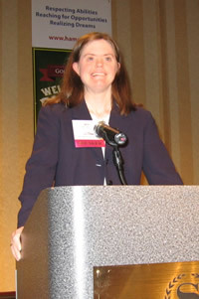
Mia Peterson
National Self Advocate
I was proud to testify before Congress on the Tenth Anniversary of the Americans with Disabilities Act.
I am also proud that I lived and worked independently in Cincinnati, Ohio, for nine years. I was the first President of People First of Ohio and was co-editor of the Community Advocacy Press.
PLAY VIDEO – MIA PETERSON
National Advocacy From Iowa – Mia Peterson

Slide 19
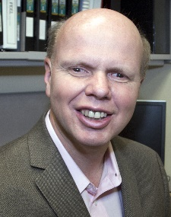
History of Disability and Aging Advocacy in Iowa
“Where the Rubber Hits the Cornfield!”
Building Peer Action Disability Support (PADS) – Mike Hoenig

Slide 20
Mike Hoenig
Program Coordinator, University of Iowa Center for Disabilities and Development - UCEDD
He is a person with a disability living in Davenport, Iowa and a long time disability advocate

Slide 21
Peer Action Disability Support (PADS) Advocacy
by Mike Hoenig
Founded in 2003 by 4 advocates including Cherie Clark
Grew from Peer Support which came about through “Living Well with a Disability” Classes
Led by People with Disabilities
Decided to work on advocacy because a member was having transportation problems
Building Peer Action Disability Support (PADS) – Mike Hoenig

Slide 22
PADS Major Accomplishments
Mike Hoenig
PADS filed a class action lawsuit against Wendy’s and WON! PADS was awarded $7,000!
Became a 501(c)(3) non-profit organization
Worked closely with local government to identify important sidewalk improvements needed to support greater mobility for wheelchair users.
Worked hard to improve local public transportation, in partnership with UI law professor Len Sandler and his interns.
Building Peer Action Disability Support (PADS) – Mike Hoenig

Slide 23
PADS Major Accomplishments
Mike Hoenig
After years of sometimes difficult conversations, the head of Linn County’s paratransit service is now a committed PADS member and disability advocate.
Provided yearly voting rights and voter education forums for Linn County residents with disabilities (in partnership with the DD Council)
Building Peer Action Disability Support (PADS) – Mike Hoenig

Slide 24
PADS Major Accomplishments
Mike Hoenig
Carried the message on disability rights to as many public venues as possible, including DHS community forums on the transportation brokerage service, legislative hearings on redesign of Iowa’s disability service system, and the public conversation on Iowa’s transition to Medicaid Managed Care.
Building Peer Action Disability Support (PADS) – Mike Hoenig

Slide 25
PADS Major Accomplishments
Mike Hoenig
Received a $30,000 AIDD Grant to help other self advocacy groups
Hosted a state-wide self advocacy summit.
Building Peer Action Disability Support (PADS) – Mike Hoenig

Slide 26
What We Do
Mike Hoenig
Host an annual ADA celebration with Cedar Rapids Kernels minor league baseball team.
Work with Public Officials like the City Council and organizations like the Cedar Rapids Public Library on accessibility issues
Have FUN!!
Building Peer Action Disability Support (PADS) – Mike Hoenig

Slide 27
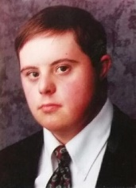
History of Disability and Aging Advocacy in Iowa
“Where the Rubber Hits the Cornfield!”
People First of North Iowa – Jeremy Beavers

Slide 28
Jeremy Beavers
About Jeremy
He is the President of the Arc of North Central Iowa, member of People First, employed at HyVee, graduated from Mason City High School, & has an associates of arts degree from Northern Iowa Area Community College.

Slide 29
People First of North Iowa
PLAY VIDEO – JEREMY BEAVERS
Presented by Jeremy Beavers
People First of North Iowa – Jeremy Beavers

Slide 30
History of Disability and Aging Advocacy in Iowa
“Where the Rubber Hits the Cornfield!”
The Iowa Centers for Independent Living – Dawn Francis

Slide 31
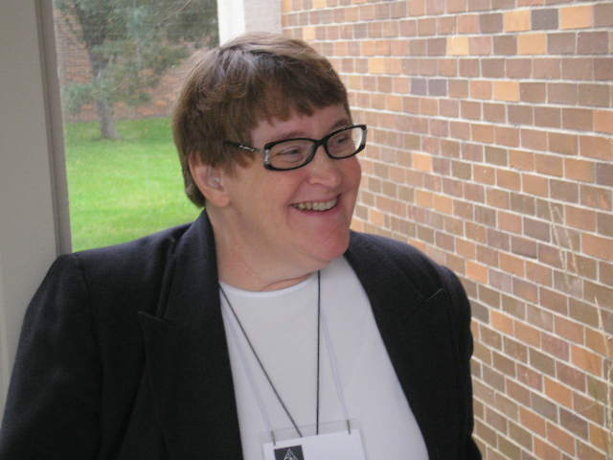
Centers for Independent Living State Funding in Iowa
In 2008, the SILC ED was having a conversation regarding going after State funding for the Iowa Centers for Independent Living (CILs) with Cherie Clark, an outstanding Iowa Disability Rights Advocate from Cedar Rapids. Cherie had a great relationship with Senator Bob Dvorsky, who represented the area where Cherie lives, and he was also Chair of the Senate Appropriations Committee. Cherie stated she would talk with him about getting State funding for the CILs.
Cherie did talk with him, and he agreed! The SILC ED mobilized the CIL Directors, staff, Boards, Consumers, and the SILC Council in an all-out campaign to contact their Legislators to have them tell Senator Dvorsky they wanted State funding for Centers!
Although the Iowa CILs asked for $1.7 million, Senator Dvorsky was able to find $250,000 in State funding for CILs! This was the first time in the history of Iowa that CILs had received ANY State funding!
In 2009, the Legislature cut that funding to zero because the CILs were getting ONE TIME ARRA federal funding. The SILC ED was able to get Senatory Dvorsky to keep in $50,000 as we needed a State match for the Part B ARRA funds.
The Iowa Centers for Independent Living – Dawn Francis

Slide 32
Iowa Governor Chet Culver Signing the Iowa Appropriations Bill Containing $250,000 in State Funding for CILs in 2008
Iowa CIL and SILC Advocates with Iowa Governor Chet Culver After 2008 Bill Signing
The Iowa Centers for Independent Living – Dawn Francis

Slide 33
History of Disability and Aging Advocacy in Iowa
“Where the Rubber Hits the Cornfield!”
ReFueling Assistance – Gary McDermott

Slide 34
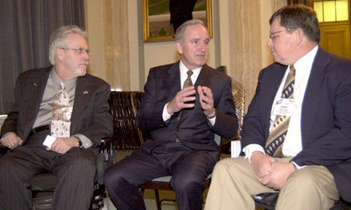
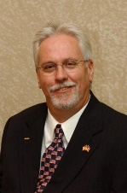
Gary McDermott
Disability & Veteran’s Rights Advocate
From Clinton, IA
The past few years I have been dedicated to the co-
authoring & advocating for legislation on behalf of
many Iowans with disabilities who are capable of driving,
However need assistance with ReFueling their vehicles.
Legislation for a direct connection wireless device to communicate with the inside clerk, operable with a closed fist from the drivers window. Tax credit available for some.
ReFueling Assistance – Gary McDermott

Slide 35
ReFueling Assistance
PLAY VIDEO – GARY MCDERMOTT
Gary McDermott
Legislative advocacy to require new and remodeled gas stations to install an improved communication device for disabled drivers to obtain fueling assistance.
ReFueling Assistance– Gary McDermott

Slide 36
History of Disability and Aging Advocacy in Iowa
“Where the Rubber Hits the Cornfield!”
Iowa Medicaid Managed Care Debacle – Don Dew

Slide 37
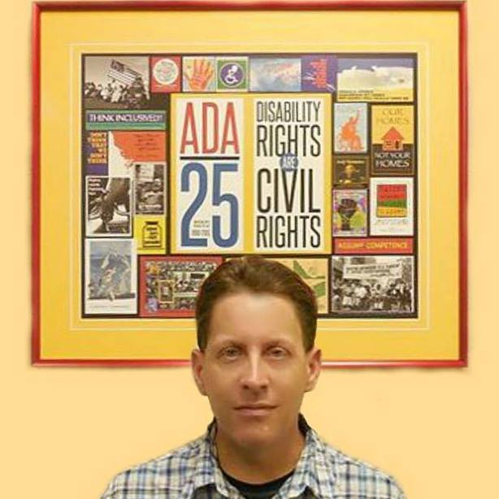
Don Dew
Disability Advocate & Person with a Disability
Executive Director of the Disabilities Resource Center of Siouxland - Sioux City, IA

Slide 38
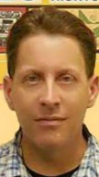
The Medicaid Managed Care DEBACLE
Don Dew
In 2015, the Governor of Iowa, without any input from Consumers, Legislators, or advocates, made the decision to move Iowa to a Medicaid Managed Care model. This involved Iowa contracting with 2 to 4 Managed Care Organizations (MCOs) to provide Medicaid services.
The Governor claimed that Iowa would save $51 million in the first year on Medicaid costs, but was never able to back up where that figure came from.
Consumers felt the savings would come from CUTTING services, even though the Governor insisted they were not going to cut services.
Iowa Medicaid Managed Care Debacle – Don Dew

Slide 39
Consumers Were Outraged
Self Advocates Get on The Bus
A small group of Consumers began developing ways to
unite people to speak out about the issues surrounding Medicaid Managed Care:
An active Facebook page was developed, called MCO Watchdog https://www.facebook.com/groups/1138399719508158/
Facebook social media EXPLODED with information and memes that were being put out by Consumers
Iowa Medicaid Managed Care Debacle – Don Dew

Slide 40
Iowa Medicaid Managed Care - DEBACLE Don Dew
Consumer organizers found an anonymous donor to fund several busloads of Consumers from all across the state to come to the Capitol in Des Moines to speak with Legislators and Rally on the Medicaid Managed Care issue. The donor also provided lunch at the Capitol.
A great many Consumers sent REPEATED e-mails to their Legislators AND to staff at the federal Center for Medicaid Services (CMS), asking for Medicaid Managed Care to be STOPPED, or at least delayed as Iowa was NOT ready to implement on January 1st. Many also attended various hearings that were being held across the state and at the Capitol to speak out on the issues.
As a result, CMS made an UNPRECEDENTED site visit to Iowa, and as a result of what they found out from that visit, CMS DELAYED implementation of Iowa Medicaid Managed Care until March 1st!
Advocates immediately pressed again to STOP Medicaid Managed Care, or to at least delay implementation longer.
Iowa Medicaid Managed Care Debacle – Don Dew

Slide 41
The Medicaid Managed Care DEBACLE
Don Dew
Consumer organizers held a second Medicaid Managed Care Rally at the State Capitol in 2016, with an anonymous donor again funding buses for Consumers from all over the state, as well as lunch at the rally.
Bottom line: CMS AGAIN DELAYED Iowa’s implementation of Medicaid Managed care to April 1st!!!
Although implementation of Medicaid Managed Care did begin on April 1st, Consumers are now working to press for a much stronger Medicaid oversight bill, and to have people document the problems they are having and e-mail them to Legislators, the MCOs, and the Ombudsman.
Iowa Medicaid Managed Care Debacle – Don Dew

Slide 42
History of Disability and Aging Advocacy in Iowa
“Where the Rubber Hits the Cornfield!”
Iowa Aging Advocacy – Jim Cushing

Slide 43
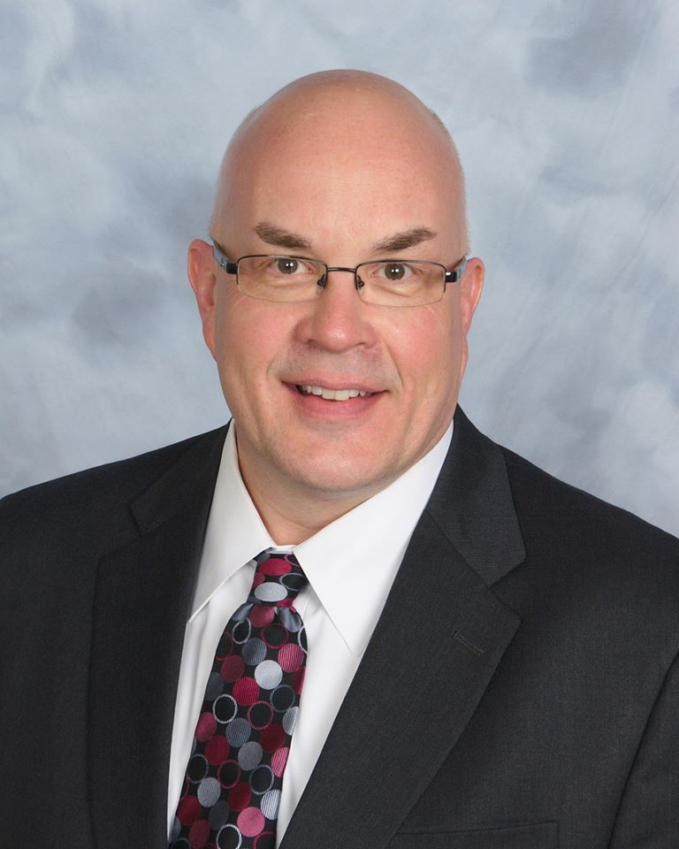
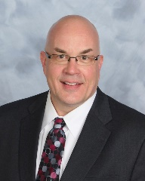
Jim Cushing
Executive Director Area Agencies on Aging
Jim Cushing is the Executive Director of the Iowa Association of the Area Agencies on Aging (AAA’s).
Iowa Aging Advocacy – Jim Cushing

Slide 44
Aging Advocacy History
Jewish Federation of Greater Des Moines – 100 yrs AARP – 1958 National Association of Area Agencies on Aging – 1975 Older Iowans Legislature (OIL) – 1978 Alzheimer’s Association – 1980 Iowa CareGivers Association – 1992 Alliance for Retired Americans – 2001 The Hale Group - 2008
Iowa Aging Advocacy – Jim Cushing

Slide 45
Aging Advocacy
Traditional Approach
Single issue or single organization focus
Information sharing
Mixed collaboration
Iowa Aging Advocacy – Jim Cushing

Slide 46
Aging Advocacy Today
The Elevate Aging Collaboration is an informal education and policy stimulation group focused on providing information about the Iowa aging journey -- preparation options and current plus developing issues. Members include AARP Iowa, Alzheimer’s Association, The Hale Group, Iowa Alliance for Retired Americans, Iowa Association of Area Agencies on Aging, Iowa CareGivers, Jewish Family Services, Office of the State Long-Term Care Ombudsman and Older Iowans Legislature. Technical assistance is provided by the Iowa Department on Aging.
Iowa Disability and Aging Advocates Network (IDAAN) – Developing collaboration between Disability and Aging groups
Iowa Aging Advocacy – Jim Cushing

Slide 47
THANK YOU!
Sign up for future webinars at www.heartlandselfadvocacy.org
Dawn Francis – dawn@iowasilc.org
Mia Peterson – miapete73@yahoo.com
Mike Hoenig– Michael-hoenig@uiowa.edu
Jeremy Beavers – beaversjeremy@hotmail.com
Gary McDermott – gmacvet@gmail.com
Don Dew- director@drcsiouxland.org
Jim Cushing – jcushing@i4.org
Special thanks to Greg Fier & Doug Cunningham for putting the presentation together.
History of Disability and Aging Advocacy in Iowa – May 6, 2016

